Slide 1


Title of the Project: A STUDY ON LANE UTILIZATION
Presented by
M. Kanaka Mahalakshmi (18331A0159) B. Yoshita (18331A0106)
S. Chakri Pavan Kumar(18331A0114) K.N.V.S. Nikhil(18331A151)
Under the guidance of
Mr. G. Rahul Reddy, Assistant Professor
Department of Civil Engineering, MVGR College of Engineering (Autonomous)

Slide 2
Objectives
To study lane discipline and lane utilization behavior for different categories of vehicles on various national highways.
To compare the results of lane utilization factors for different lanes and vehicles observed on the road.
To model lane utilization using parameters like classified traffic volume and average stream speed for prevailing roadway and traffic conditions on the selected area of study.

Slide 3
Overall Methodology
The main data collection task was to manually collect the categorical vehicular count i.e., car, two-wheeler, three-wheeler, heavy good vehicle through an instantaneous cross section of the lane in individual lanes at peak hour. The time periods for data collection were opted out such that it covers wider variation of traffic flow conditions.
For the purpose of calculating lane utilization, the lanes were classified into three distinct types (1 denoting right-shoulder side, 2 denoting right median side, 3 denoting left median side, 4 denoting left-shoulder side, 1.5 and 3.5), each representing vehicle position on the national highway from the median, hence making it possible to quantify the degree of lane-discipline followed under the prevailing basic roadway and traffic conditions.

Slide 4
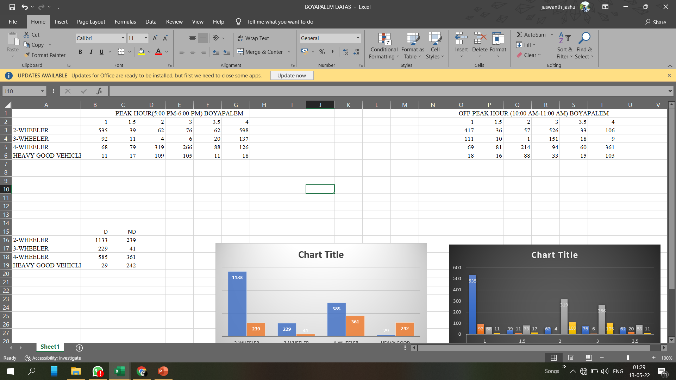
Data on lane distribution of different categories of vehicles collected on the area of work

Slide 5
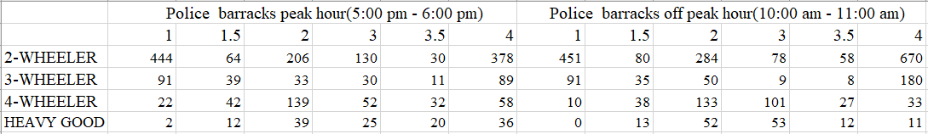
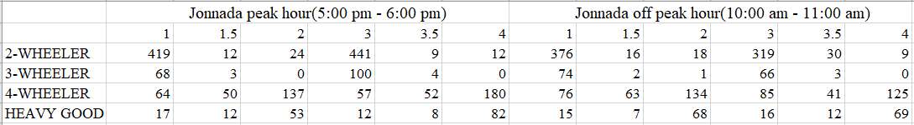

Slide 6
D – Disciplinary ND – Non-Disciplinary

Slide 7
LUF at NH16 BOYAPALEM
Lane | Total Volume | LUF
1 | 706 | 0.8
2 | 494 | 0.562
3 | 453 | 0.515
4 | 879 | 1

Slide 8
Results
The lane discipline is concerned, two-wheelers 97.1%, 78.5%, 93.7%, 65.6%, three-wheeler 84.8%,100%, 96%, 61.4%, four-wheeler 94.9%, 70%, 58.7%, 55.3%, Heavy Good Vehicles 10.7%, 7.4%, 15.7%, 28.3% at Boyapalem, Ghambiram, Jonnada, Police Barracks respectively follow the lane discipline.
The Lane Utilization Factors at Boyapalem breaks down to 0.8, 0.562, 0.515,1 and at Ghambiram 0.75, 1, 1, 0.81, 0.97, 0.65, at Jonnada the LUF is 0.93, 0.35, 0.44, 1 and at Police Barracks 0.99, 0.74, 0.422, 1 at lanes 1, 2, 3 and 4 (5 and 6 lanes at Ghambiram) respectively.

Slide 9
Conclusions
Because of smaller size, all the two-wheelers are found to follow lane-discipline. In a single designated lane, the parallel movement of two two-wheelers was observed simultaneously, which may be possible only by virtue of their smaller size.
It is observed that there are significant number of cars, three-wheelers and heavy vehicles which do not follow perfect lane-discipline.

Slide 10
Conclusions
But, this observed degree of lane based vehicle movement is relatively different as compared to the other multilane roads (National Highways, urban arterial roads, etc.) in India.
It is also found that the proportion of cars linearly decreases from median side lane to shoulder side lane i.e. from lane-1 to lane-4, whereas the proportion for two-wheelers, three-wheelers, trucks and buses linearly increases from lane-1 to lane-4.

Slide 11
References
Amin, M. R. and Banks, J. H. (2005). "Variation in Freeway Lane use Patterns with Vlume, Time of Day, and Location." J. Transportation Research Board, No. 1934, 132-139.
Banks, J.H. (2006). "Effect of Time Gaps and Lane use Distributions on Freeway Bottleneck Capacity." J. Transportation Research Board, No. 1965, 3-11
Sagar Kurlea , Krishna N. S. Behara a, Rajendra Prasad J.a , Shriniwas Arkatkarb,*, Ashoke Kumar Sarkara. “Study of Lane Utilization on Delhi-Gurgaon Expressway”

Slide 12
Thank you
Department of Civil Engineering, MVGR College of Engineering (Autonomous)

